Slide 1


Convolution
Tom Zimmerman
IBM Research-Almaden
Center for Cellular Construction
2.15.22
This material is based upon work supported by the NSF under Grant No. DBI-1548297.
Disclaimer: Any opinions, findings and conclusions or recommendations expressed in this material are those of the authors and do not necessarily reflect the views of the National Science Foundation.

Slide 2
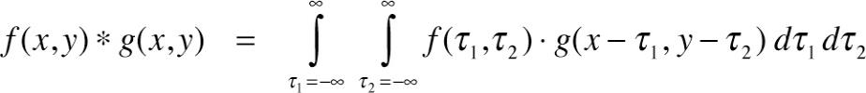
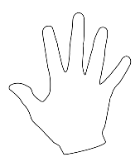
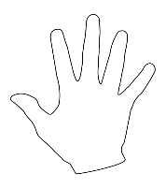
Correlation is measurement of the similarity between two signals.
Convolution is measurement of effect of one signal on the other signal.
Multiplication in Frequency Domain = Convolution in Spatial Domain
Correlation Example
0 .25 .95 1.0
https://www.mathworks.com/matlabcentral/answers/264746-difference-between-convolution-and-correlation
https://upload.wikimedia.org/wikipedia/commons/thumb/f/fa/Hand.svg/512px-Hand.svg.png

Slide 3
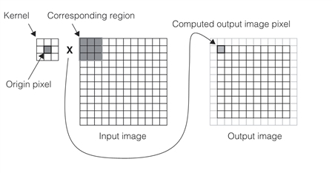
https://support.cognex.com/docs/cvl_900/web/EN/cvl_vision_tools/Content/Topics/VisionTools/Image_Convolution.htm

Slide 4
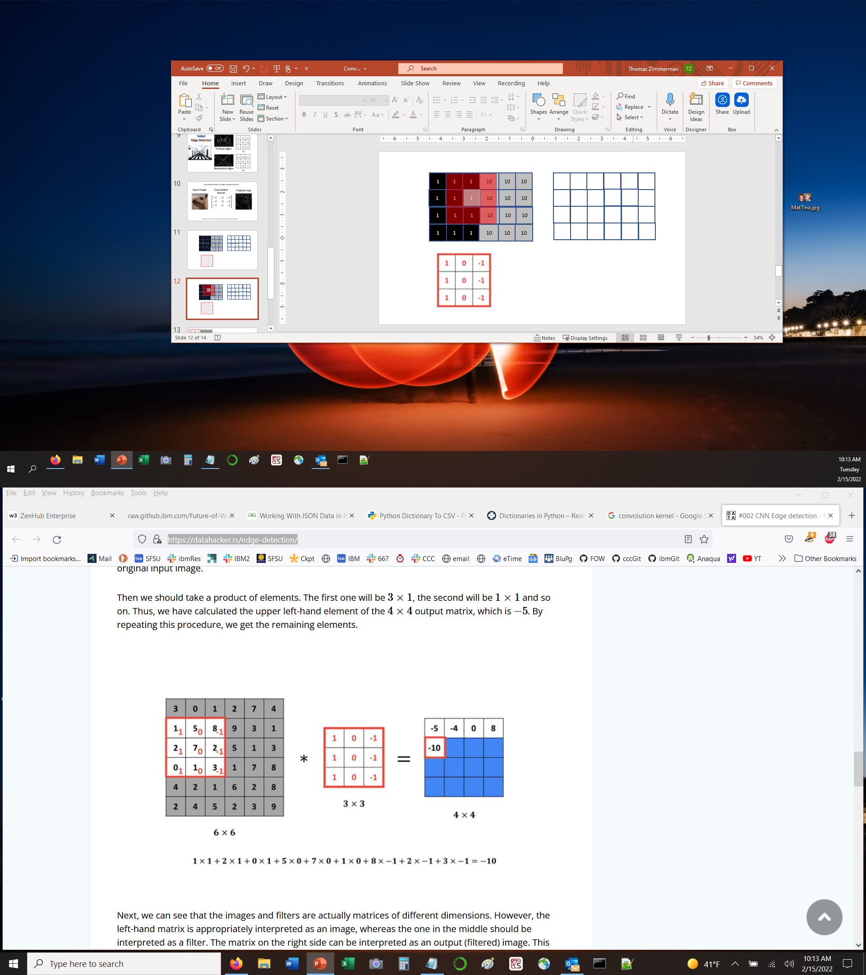
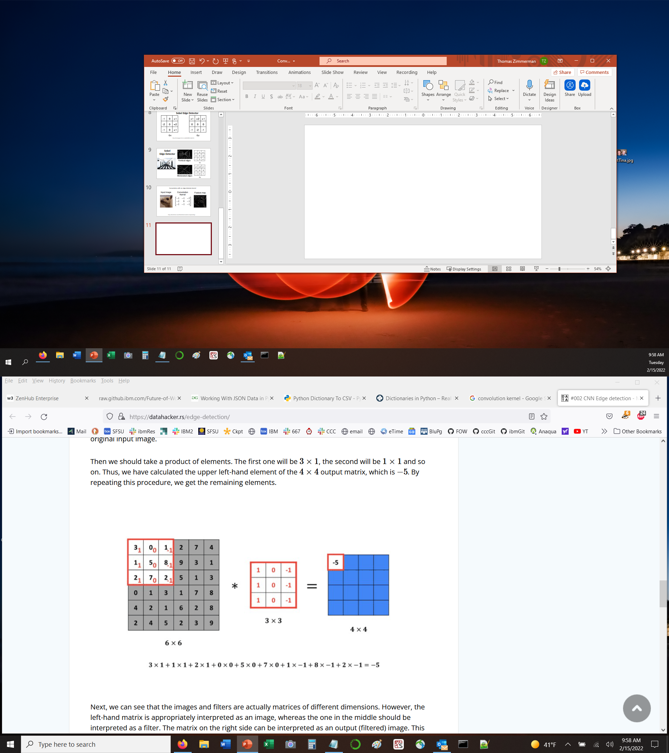
Vertical Edge Detector
1
1
1
10
10
10
1
1
1
10
10
10
0
-27
-27
0
1
1
1
10
10
10
0
-27
-27
0
1
1
1
10
10
10

Slide 5
Low Pass (Blur) Filter
1
1
1
8
8
8
1
1
1
8
8
8
1
1
3.6
5.4
1
1
1
8
8
8
1
3.6
5.4
1
1
1
1
8
8
8
1/8
1/8
1/8
1/8
1/8
1/8
1/8
1/8
1/8
3/8~0.4
5/8~0.6

Slide 6
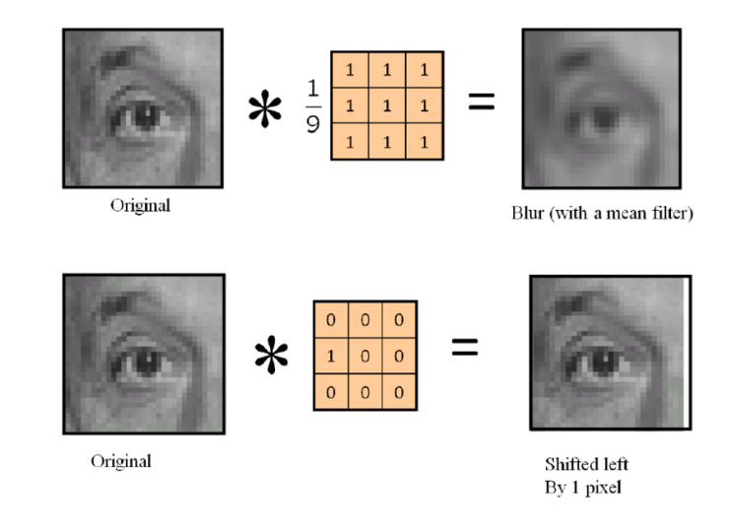
Blur, Shift Filters
https://m.blog.naver.com/PostView.naver?isHttpsRedirect=true&blogId=framkang&logNo=220561249726

Slide 7
https://datahacker.rs/edge-detection/

Slide 8
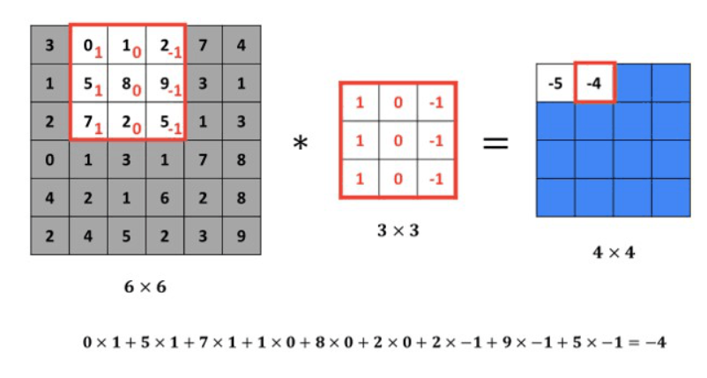
https://datahacker.rs/edge-detection/

Slide 9
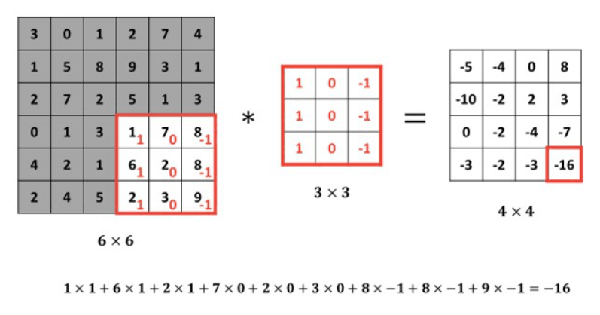

Slide 10
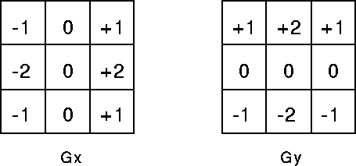
Sobel Edge Detector
https://homepages.inf.ed.ac.uk/rbf/HIPR2/sobel.htm

Slide 11
1
1
1
10
10
10
1
1
1
10
10
10
1
1
1
10
10
10
1
1
1
10
10
10

Slide 12
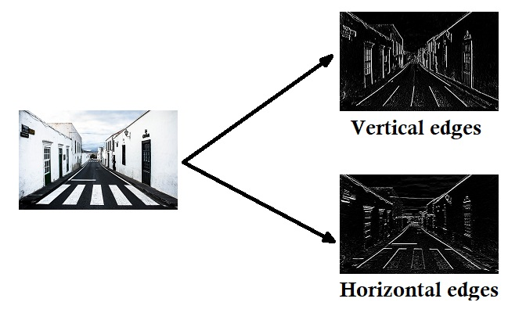
Sobel
Edge Detector

Slide 13
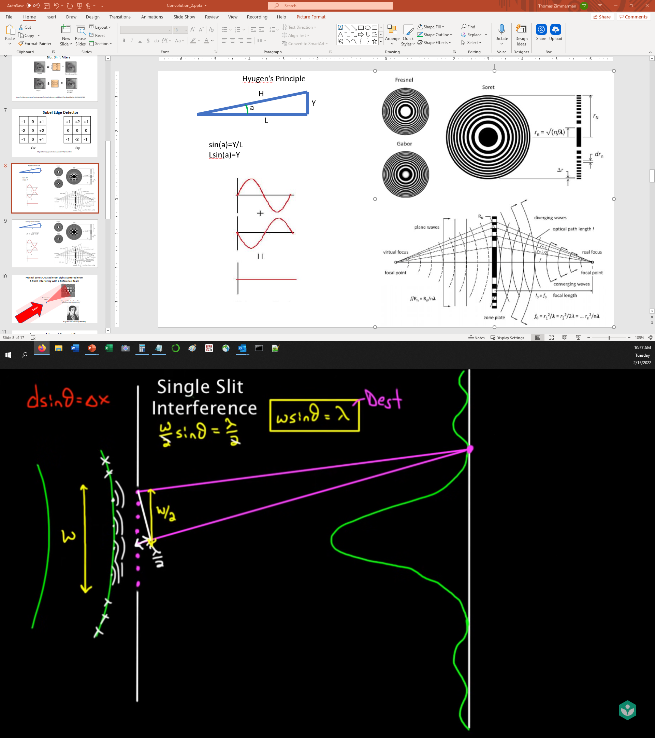
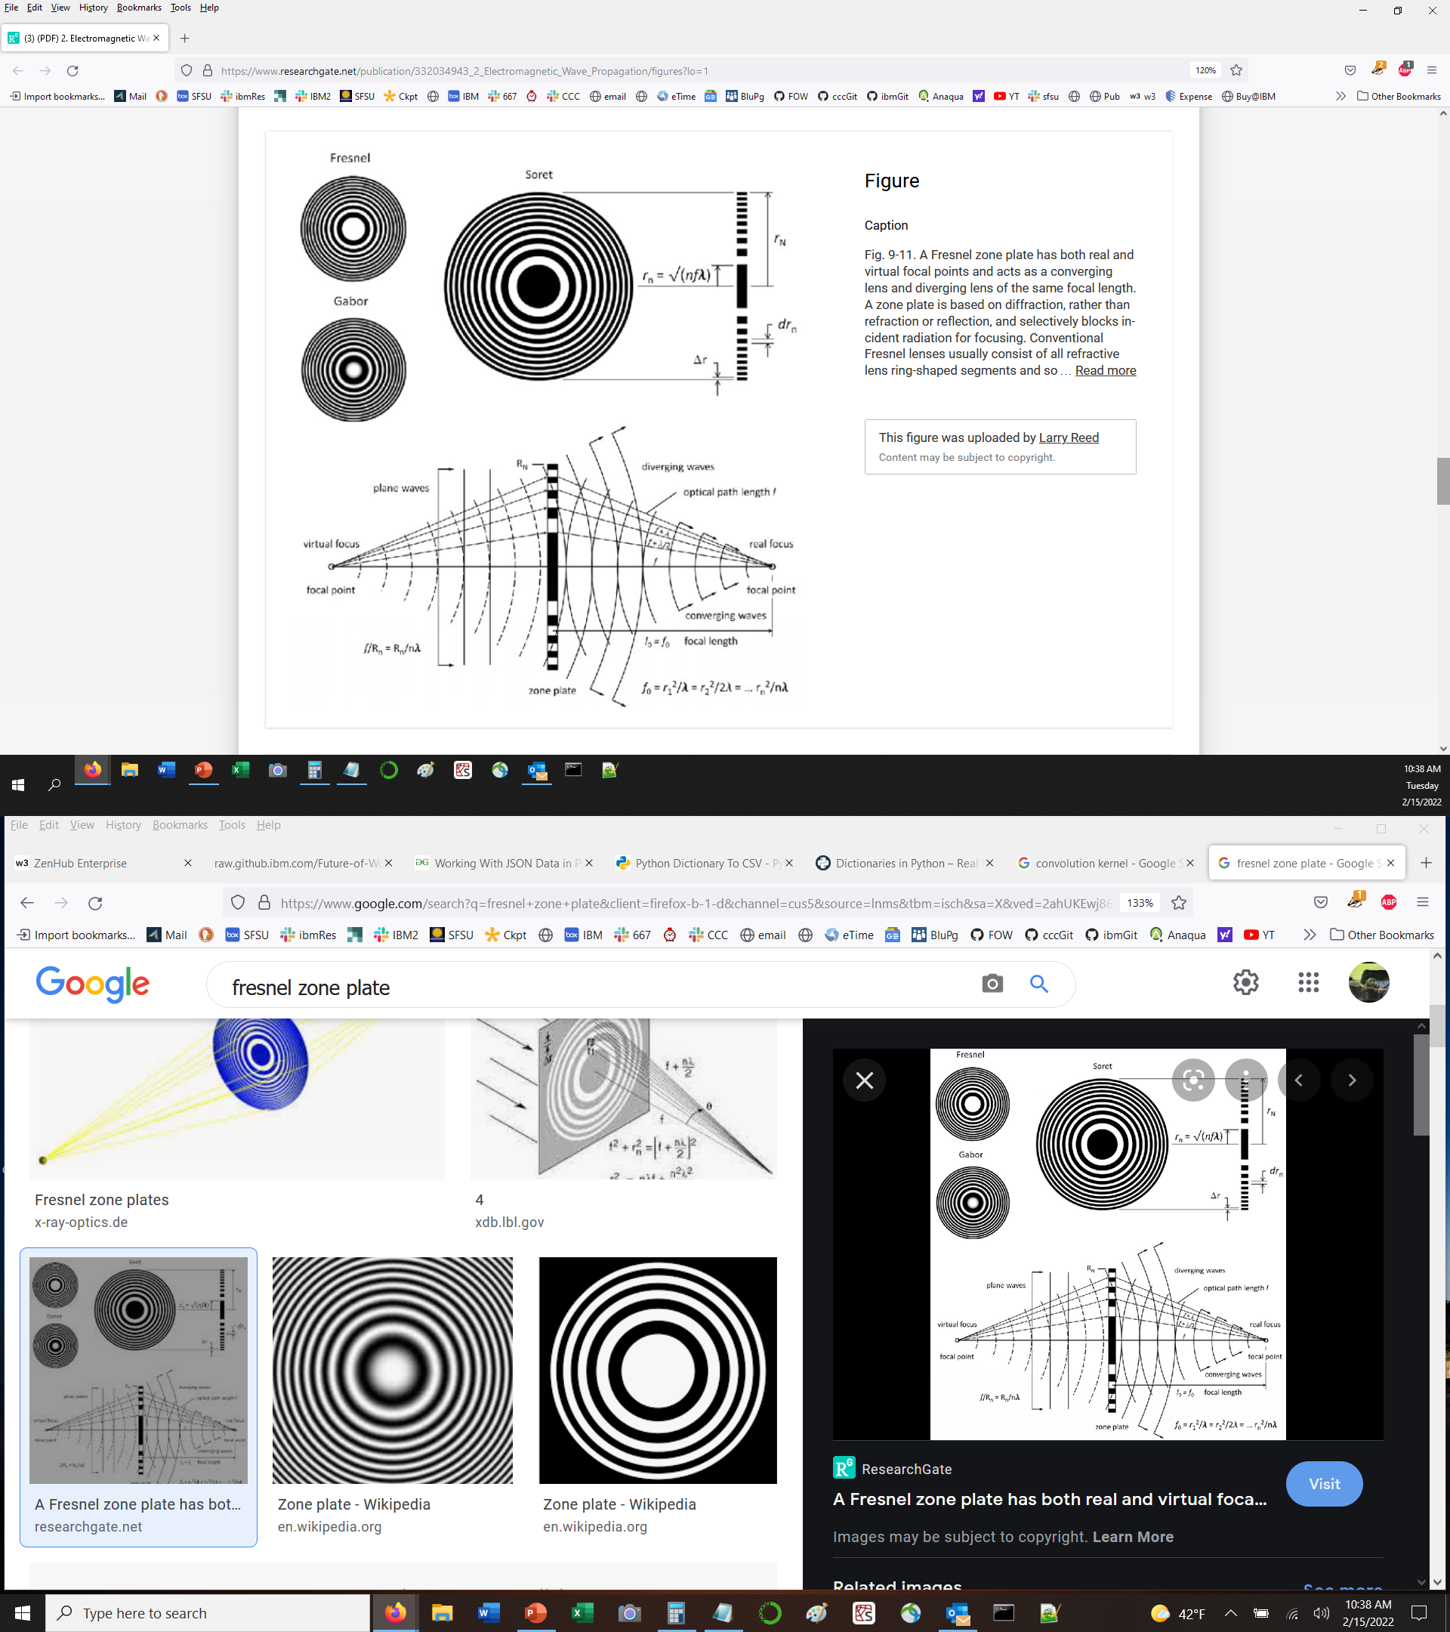
Single Slit Interference Khan Academy https://youtu.be/7CmbItRjM-Y

Slide 14
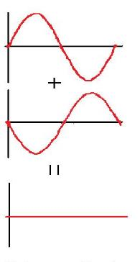
c
b
theta
a
c-a=M*wavelength/2

Slide 15
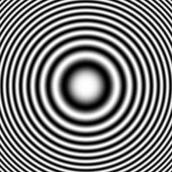
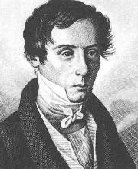
Fresnel Zones Created From Light Scattered From A Point Interfering with a Reference Beam
Reconstructed
Subject
Photographic Film of Interference Pattern
(Fresnel Zone Plate for point source)
Laser
Augustin-Jean Fresnel (1788-1827)

Slide 16
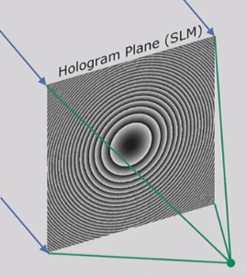
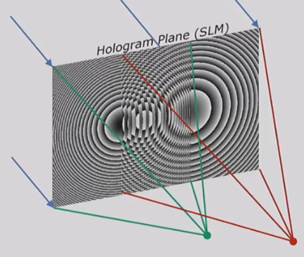
Superposition of Fresnel Zones
One point object Two point objects (superposition)
Laser
Laser
https://youtu.be/oq9UsYHyUvo

Slide 17
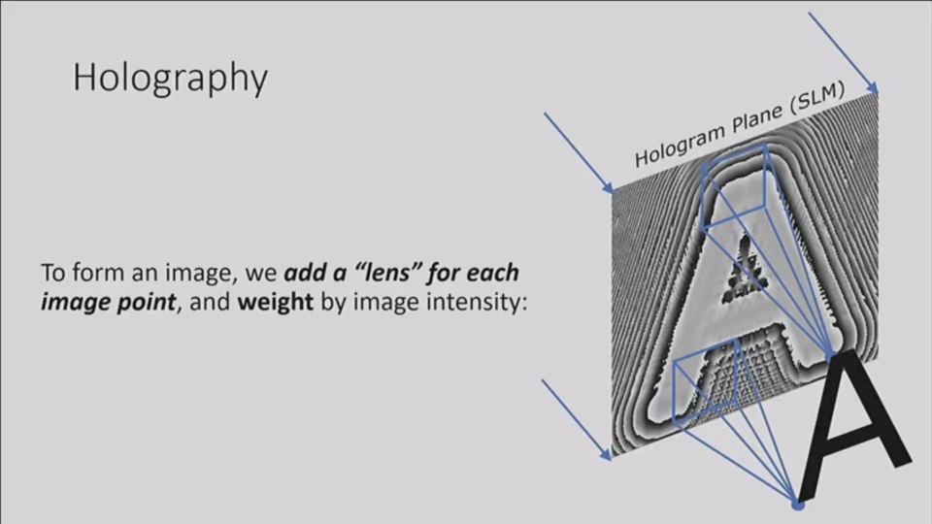
Model Complex Object As Lots of Point Objects
https://youtu.be/oq9UsYHyUvo

